Slide 1
ENEL 419 Probability and Random Variables
Additional Tutorial Examples: PMF, CDF, Special Random Variables

Slide 2
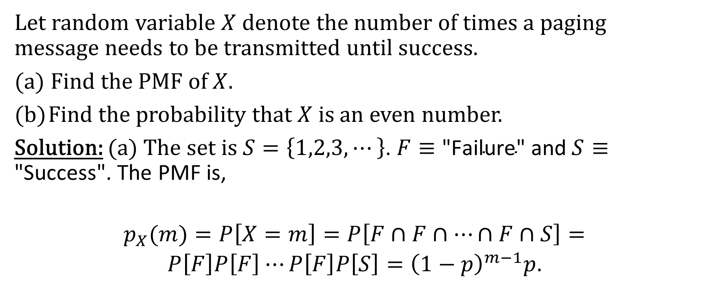
Example 1 – PMF of Geometric Random Variable
Let random variable $X$ denote the number of times a paging message needs to be transmitted until success.
(a) Find the PMF of $X$.
Find the probability that $X$ is an even number.
Solution: (a) The set is $S=\left\{1,2,3,⋯\right\}$. $F≡\text{"}\text{Failure}\text{" }\text{and} S≡\text{"}\text{Success}\text{".}$ The PMF is,
$p_{X}(m)=P\left[X=m\right]=P\left[F∩F∩⋯∩F∩S\right]=P\left[F\right]P\left[F\right]⋯P\left[F\right]P\left[S\right]={\left(1−p\right)}^{m−1}p$.

Slide 3

Example 1 – PMF of Geometric Random Variable
Solution: (b)
$$\begin{aligned}P\left[X \text{is} \text{even}\right]=P\left[X=2\right]+P\left[X=4\right]+⋯=\sum_{m=1}^{∞}{p(2m)}=p\sum_{m=1}^{∞}{{\left(1−p\right)}^{2m−1}} \\ =p\sum_{m=1}^{∞}{{\left(1−p\right)}^{2m−2+1}}=p\left(1−p\right)\sum_{m=1}^{∞}{{\left({\left(1−p\right)}^{2}\right)}^{m−1}} \\ =p\frac{1−p}{1−{\left(1−p\right)}^{2}}=\frac{1−p}{2−p}\end{aligned}$$

Slide 4
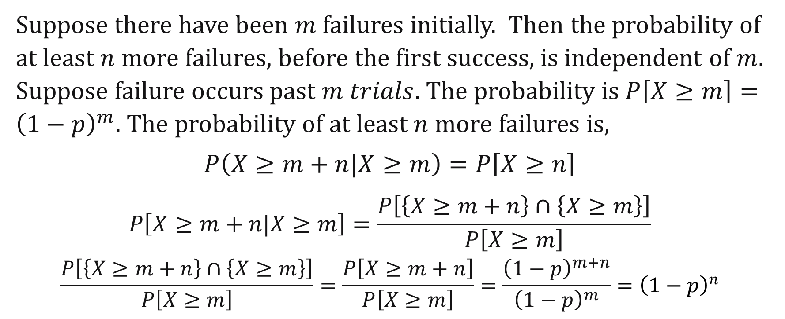
Example 2 – Memoryless Property of the Geometric Distribution
Suppose there have been $m$ failures initially. Then the probability of at least $n$ more failures, before the first success, is independent of $m$. Suppose failure occurs past $m trials$. The probability is $P\left[X≥m\right]={\left(1−p\right)}^{m}$. The probability of at least $n$ more failures is,
$$P\left(X≥m+n|X≥m\right)=P\left[X≥n\right]$$
$$P\left[X≥m+n|X≥m\right]=\frac{P\left[\left\{X≥m+n\right\}∩\left\{X≥m\right\}\right]}{P\left[X≥m\right]}$$
$$\frac{P\left[\left\{X≥m+n\right\}∩\left\{X≥m\right\}\right]}{P\left[X≥m\right]}=\frac{P\left[X≥m+n\right]}{P\left[X≥m\right]}=\frac{{\left(1−p\right)}^{m+n}}{{\left(1−p\right)}^{m}}={\left(1−p\right)}^{n}$$

Slide 5
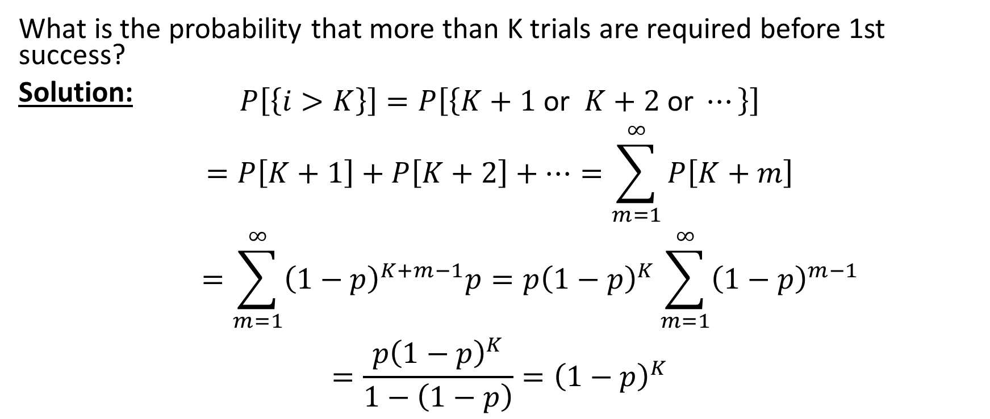
Example 3 – Memoryless Property of the Geometric Distribution
What is the probability that more than K trials are required before 1st success?
Solution:
$$\begin{aligned}P\left[\left\{i>K\right\}\right]=P\left[\left\{K+1 \text{or} K+2 \text{or} ⋯\right\}\right] \\ =P\left[K+1\right]+P\left[K+2\right]+⋯=\sum_{m=1}^{∞}{P\left[K+m\right]} \\ =\sum_{m=1}^{∞}{{\left(1−p\right)}^{K+m−1}p}=p{\left(1−p\right)}^{K}\sum_{m=1}^{∞}{{\left(1−p\right)}^{m−1}} \\ =\frac{p{\left(1−p\right)}^{K}}{1−\left(1−p\right)}={\left(1−p\right)}^{K}\end{aligned}$$

Slide 6
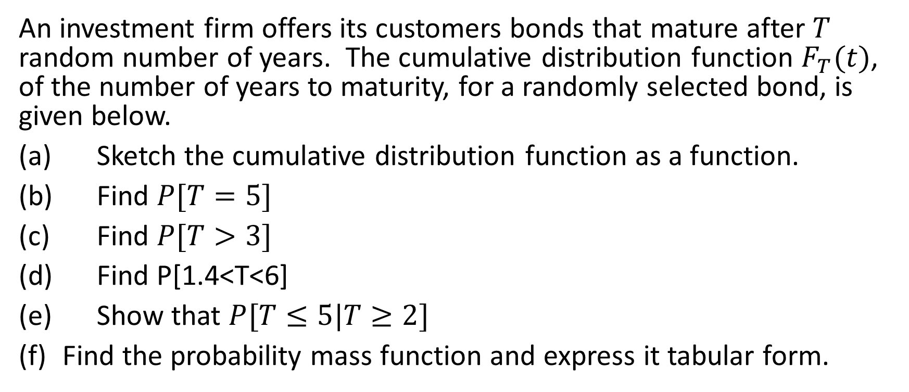
Example 4
An investment firm offers its customers bonds that mature after $T$ random number of years. The cumulative distribution function $F_{T}(t)$, of the number of years to maturity, for a randomly selected bond, is given below.
(a) Sketch the cumulative distribution function as a function.
(b) Find $P[T=5]$
(c) Find $P[T>3]$
(d) Find P[1.4<T<6]
(e) Show that $P[T≤5|T≥2]$
Find the probability mass function and express it tabular form.

Slide 7
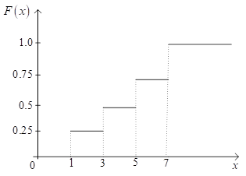
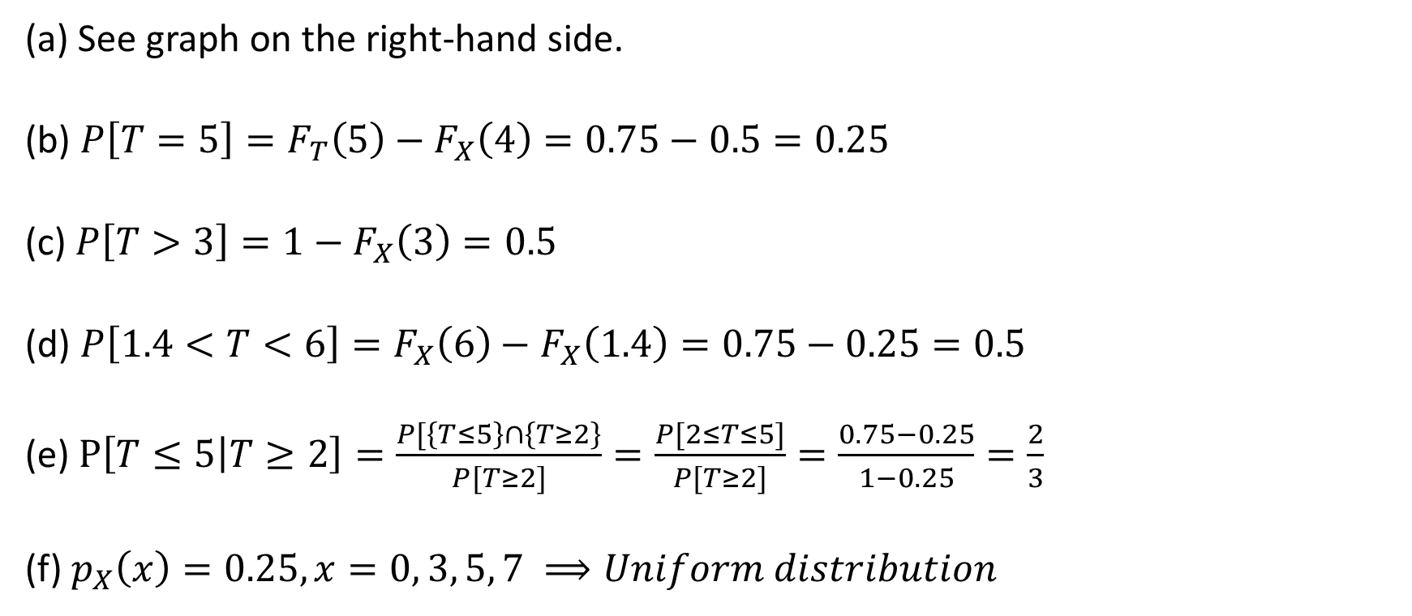
Example 4 Solutions
(a) See graph on the right-hand side.
(b) $P\left[T=5\right]=F_{T}\left(5\right)−F_{X}\left(4\right)=0.75−0.5=0.25$
(c) $P\left[T>3\right]=1−F_{X}\left(3\right)=0.5$
(d) $P\left[1.4<T<6\right]=F_{X}\left(6\right)−F_{X}\left(1.4\right)=0.75−0.25=0.5$
(e) $P\left[T≤5 | T≥2\right]=\frac{P[\left\{T≤5\right\}∩\left\{T≥2\right\}}{P[T≥2]}=\frac{P[2≤T≤5]}{P[T≥2]}=\frac{0.75−0.25}{1−0.25}=\frac{2}{3}$
(f) $p_{X}\left(x\right)=0.25, x=0, 3, 5, 7 ⟹Uniform distribution$

Slide 8
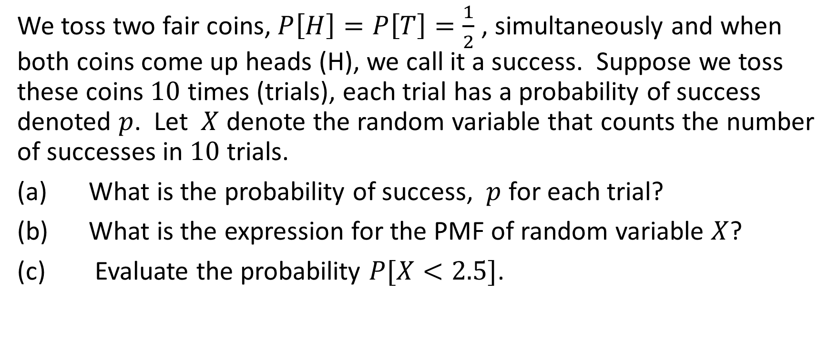
Example 5
We toss two fair coins, $P\left[H\right]=P\left[T\right]=\frac{1}{2}$ , simultaneously and when both coins come up heads (H), we call it a success. Suppose we toss these coins $10$ times (trials), each trial has a probability of success denoted $p$. Let $X$ denote the random variable that counts the number of successes in $10$ trials.
(a) What is the probability of success, $p$ for each trial?
(b) What is the expression for the PMF of random variable $X$?
(c) Evaluate the probability $P[X<2.5]$.

Slide 9
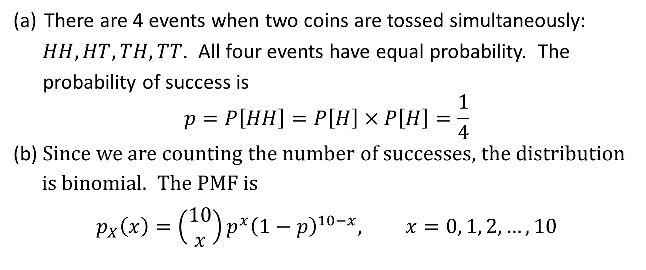
Example 5 Solutions
There are 4 events when two coins are tossed simultaneously:
$HH, HT, TH, TT$. All four events have equal probability. The
probability of success is
$$p=P\left[HH\right]=P\left[H\right]×P\left[H\right]=\frac{1}{4}$$
(b) Since we are counting the number of successes, the distribution
is binomial. The PMF is
$$p_{X}\left(x\right)=\left(\begin{aligned}10 \\ x\end{aligned}\right)p^{x}{\left(1−p\right)}^{10−x}, x=0, 1, 2, …, 10$$

Slide 10

Example 5 Solutions
(c) $X<2.5⇒X=x=0, 1, 2$
$p_{X}\left(x\right)=\left(\begin{aligned}10 \\ x\end{aligned}\right)p^{x}{\left(1−p\right)}^{10−x}, x=0, 1, 2 \left(p=\frac{1}{4}\right)$

Slide 11
Example 6
From a box containing 4 dimes and 2 nickels, 3 coins are selected at random without replacement. Find the PMF for the total value of the 3 coins selected.
Solutions:
Total values of 3 coins selected: 2 nickels + 1 dime (20 cents), 1 nickel + 2 dimes (25 cents) or 3 dimes (30 cents).

